Slide 1
Cisco OMD Feature Update

Slide 2
Agenda
Pull Requests coming soon (once ported to TC2.1)
Session Tracking
Delivery Service Custom FQDN
CORS Support
Anonymous IP Blocking
DSCP Marking Mid->Edge
Client Subnet in DNS
In Progress Now
Device Groups
Notes:
Other small stuff
Multiple Transaction Log Formats

Slide 3
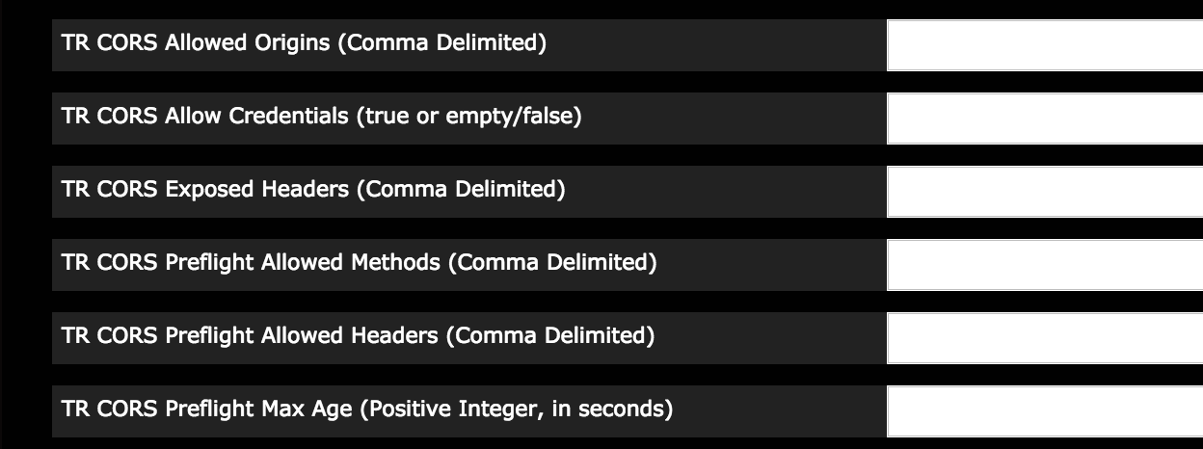
CORS Support
Allow delivery of content from Referers on other domains
Common Use Case: Web-Based Video Portal not hosted on CDN
Traffic Router Changes
Supports simple and preflight requests.
TS Lua Plugin to strip “Origin: null”
Works at DS Level instead of Tomcat CORS Filter (Servlet Level)
Owner: Hongfei Zhang
Notes:
W3 standard
Uses a predefined set of HTTP headers/methods that allow servers to describe the set of origins that are permitted to access resources using a web browser
Browser requests describes intention and fails requests if CORS requirements are not met
Server responds based on CORS policy settings
OMD support is to Enable web browser based media players to access contents served via CDN
Provide CDN operators policy-based CORS controls
Support both Simple and Non-Simple (preflight + actual) requests
Applicable only to HTTP(s) based CDN content routing (HTTP redirect).

Slide 4
Anonymous IP Blocking
Prevents access to content from users on VPNs and Anonymous Proxies
Sometimes required contractually by Content Provider
Block requests at TR based on Maxmind Anonymous IP Database
New TR Parameter provides path to per-CDN config file
Block by category: VPN, Anonymous Proxy, ToR Exit Node, Hosting Provider
IP Whitelists
Currently integrating into Client DS Steering
Owner: Peter Ryder

Slide 5
Anonymous IP Blocking Example Config
{ "customer": "Cisco", "version": "1", "date" : "2017-05-23 03:28:25", "name": "Anonymous IP Blocking Policy", "anonymousIp": { "blockAnonymousVPN": true, "blockHostingProvider": true, "blockPublicProxy": true, "blockTorExitNode": false}, "ip4Whitelist": ["192.168.30.0/24", "10.0.2.0/24", "5.34.32.0/24"], "ip6Whitelist": ["2001:550:90a::/48", "::1/128"] }

Slide 6
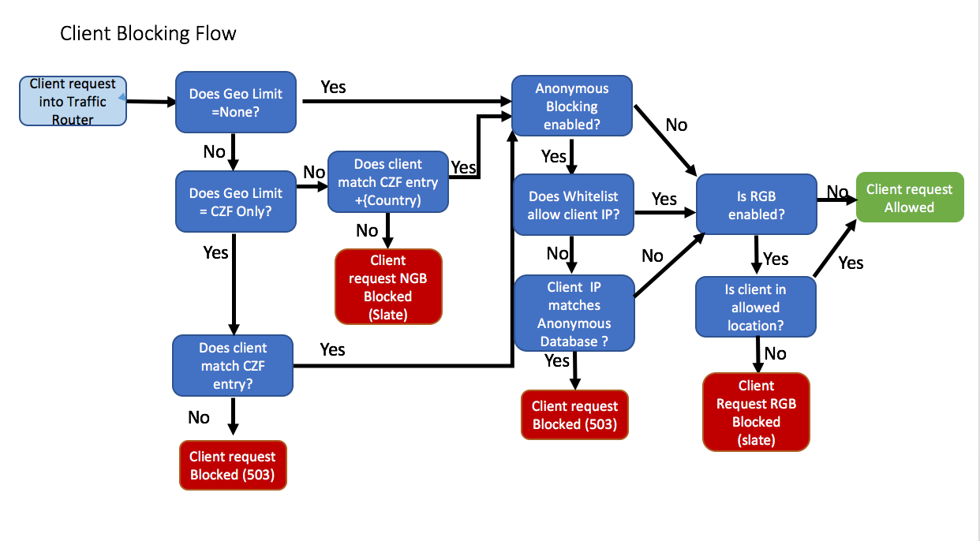
TR Blocking Flowchart

Slide 7
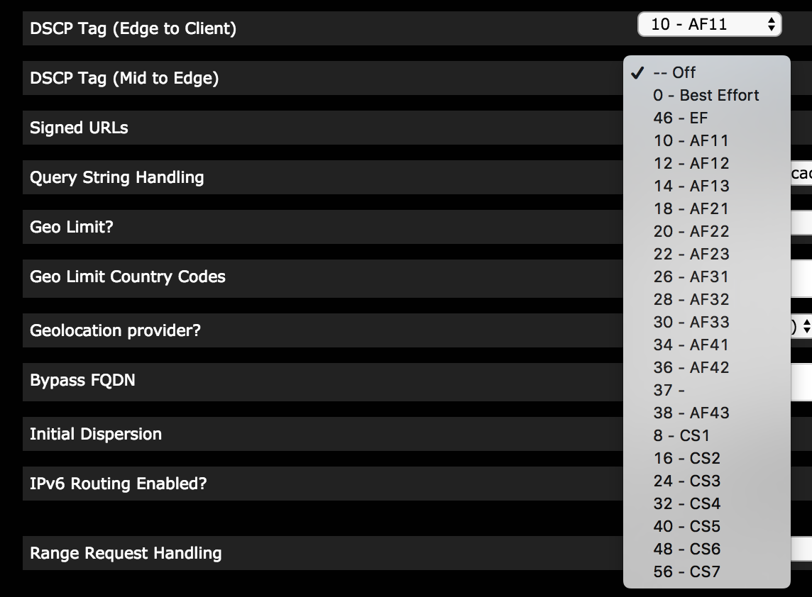
Mid Cache DSCP Marking
Prioritize traffic within CDN across Service Provider links.
Set DSCP field on cache fill response from mid to edge
To distinguish between delivery services with same origin domain_name, set Forwarded header in request to mid
Mid cache filters on Forwarded header to set DSCP on response
TO generates header_rewrite per DS this is enabled on
Owner: Mike Sandman

Slide 8
Mid Cache DSCP Marking Code
Edge Lua script
ts.server_request.header['Forwarded'] = 'host=' .. ts.client_request.header['Host']
Mid Header Rewrite
cond %{HEADER:Forwarded} /host=<DS RFQDN>/ cond %{REMAP_PSEUDO_HOOK} set-conn-dscp 20 [L]

Slide 9
Client Subnet in DNS
Enable TR to provide better DNS routing decisions using client IP instead of resolver IP
Support for RFC7871 – Client Subnet in DNS
DNS Resolvers embed Client Subnet in EDNS0 ECS field
Traffic Router DNS takes client IP from ECS
TR response includes matching “scope” to aid in caching
Disabled by default, enable with ecs_enable parameter in CRConfig.json

Slide 10
Client Subnet Flow Diagram
Client
#1
DNS Resolver
#2
Traffic Router
IP=192.168.1.1
#4
#3
IP=10.1.1.1
Client queries live.cdn.com
Recursive lookups resulting in Q live.cdn.com to TR w/ ECS source=192.168.1.1/32
TR Response for live.cdn.com w/ ECS scope=192.168.1.1/32
Optional caching in resolver based on scope
Response to client for live.cdn.com

Slide 11
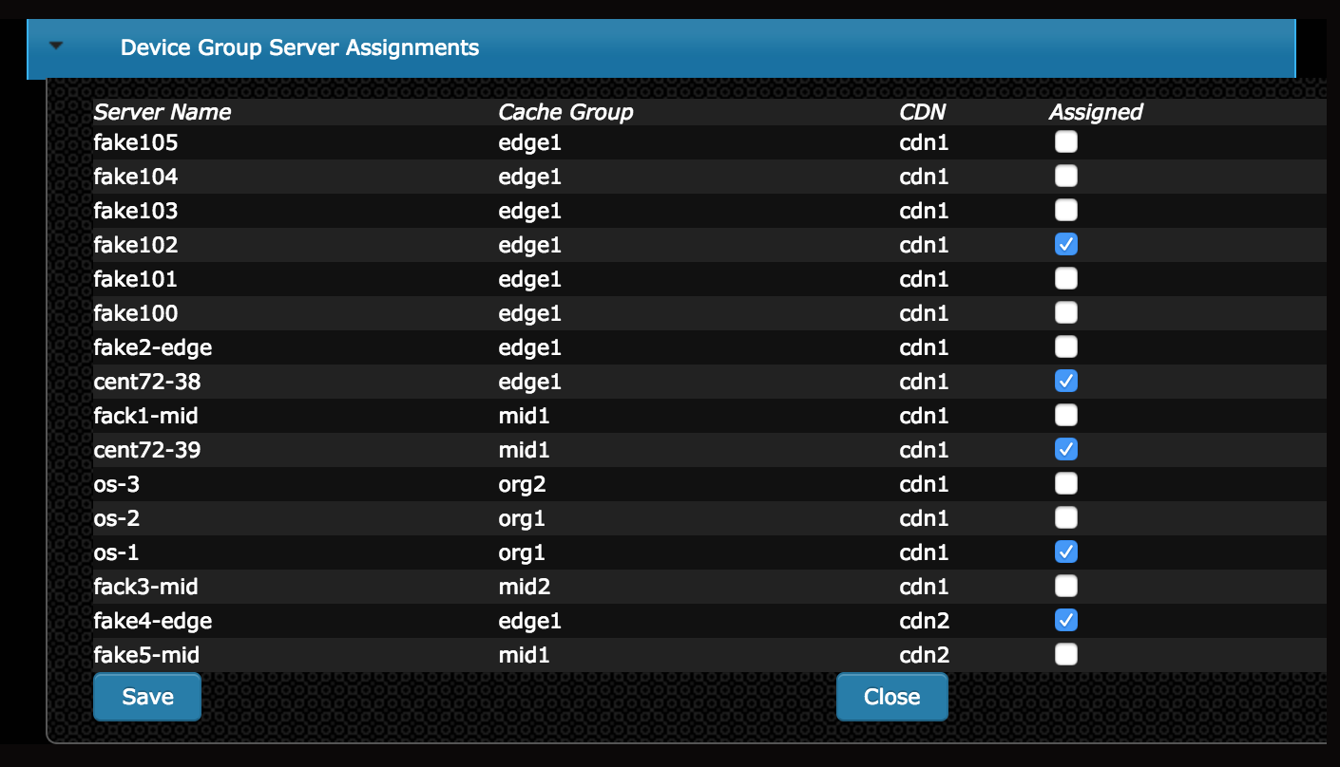
Device Groups
New logical grouping of Servers
Provides easier management of large numbers of servers
Allows modification of distribution topology for individual delivery services
Create device groups for specific roles of servers (i.e. VOD ABR, VOD PDL)
TO Profiles not sufficient – device groups may overlap.
Assign all servers belonging to device group to delivery services in 1 step.
Owner: John Shen

Slide 12
Device Group – Distribution Topology
Mid caches are implicitly chosen from the device group
Delivery Services on same edge cache may now use different MIDs
Mid CG - West
Mid CG - East
DG1
Movies DS
- Assigned Edge CG East
Sports DS
- Assigned DG1
Edge CG - East
DG1

